Slide 1
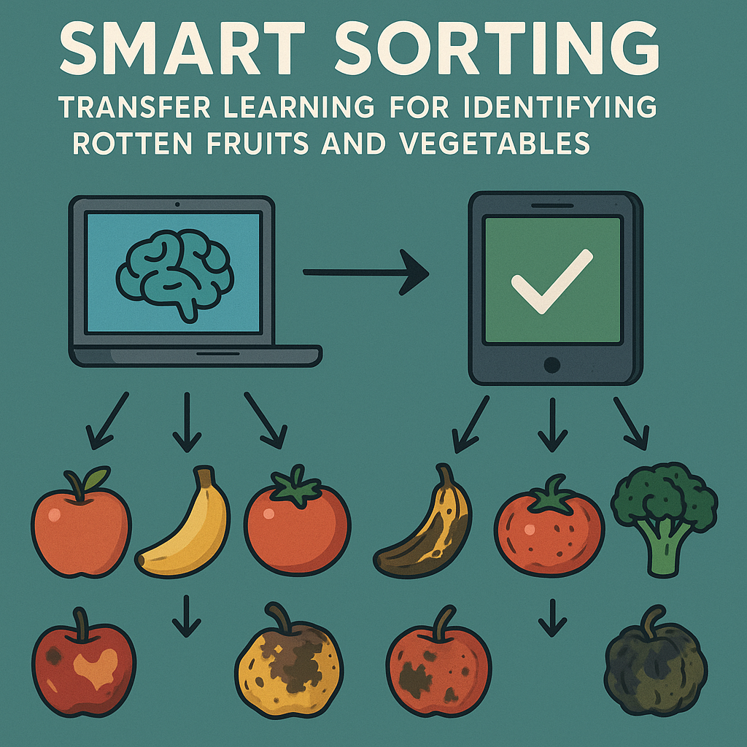
Smart Sorting uses deep learning to tackle food waste and quality control issues in agriculture and retail. With a large portion of food lost to spoilage in India, this system helps automate the detection of rotten produce, reducing waste and improving efficiency.
Smart Sorting: Transfer Learning for Identifying Rotten Fruits and Vegetables
BY P. Tarun kumar Nagedda Leela Shakunya Devi Nangedda Baby Sai Nandhini Narra Simhadri

Slide 2
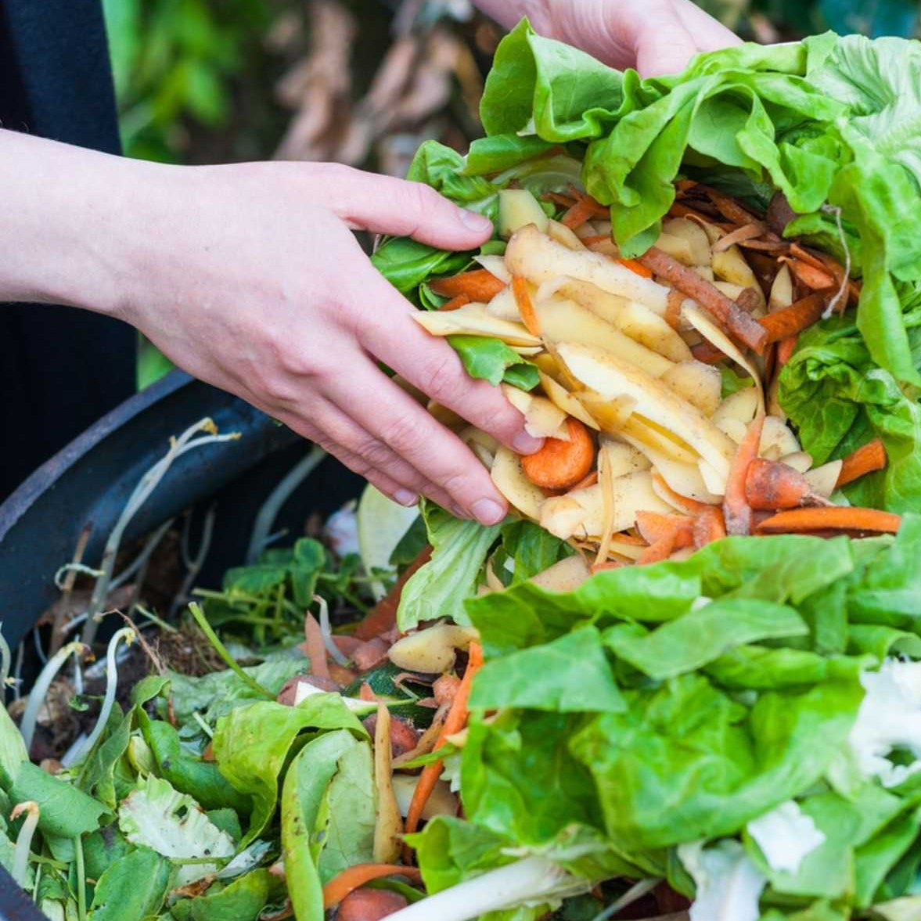

Project Description
precision and efficiency in detecting rotten fruits and vegetables using transfer learning. It adapts pre-trained deep learning models to identify spoiled produce, revolutionizing quality control in agriculture and food industries.

Slide 3
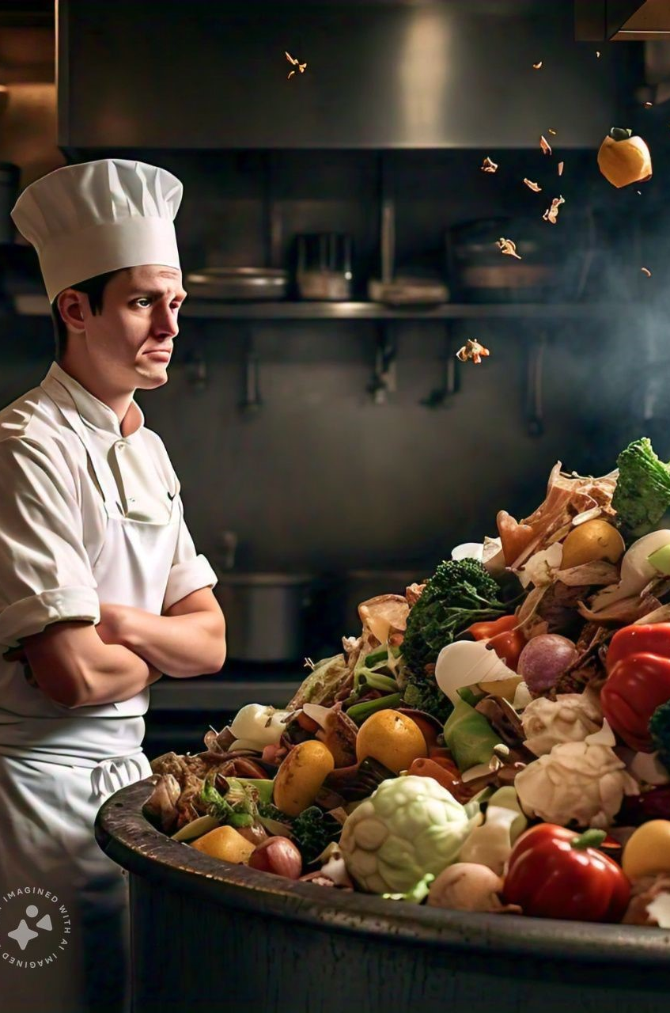
Automated Inspection
Accurate, real-time detection of rotten fruits and vegetables using deep learning for farms, supermarkets, and homes.
Transfer Learning Model
Built on pre-trained CNNs, adapted to classify multiple fruits and vegetables with high precision.
Smart Applications
Supports integration with conveyor belts, smart fridges, and mobile apps to minimize food waste and maximize freshness.

Slide 4
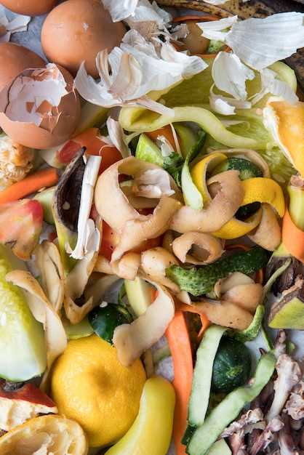
Benefits
Reduces food waste
- Improves supply chain efficiency
- Enhances consumer satisfaction
- Automates quality control

Slide 5
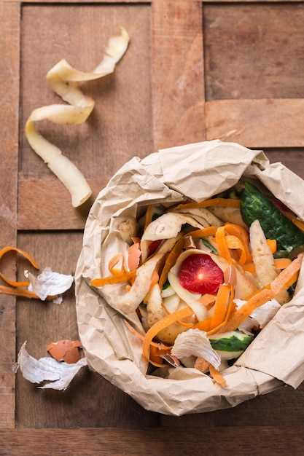
Data Ingestion
Collects image data of various fruits and vegetables — both fresh and rotten — using high-resolution cameras in farms, warehouses, or markets.
01
02
Feature Engineering
ML Models
03
04
Smart Food Labels
Staff Training
FRUITS AND VEGETABLES

Slide 6
The Smart Sorting project demonstrates the effective use of deep learning and transfer learning in real-world food quality control. By accurately detecting rotten fruits and vegetables, it enhances food safety, reduces waste, and supports better health outcomes. The web-based interface makes it user-friendly and accessible. Overall, the system provides a smart, scalable solution for modern agriculture and retail.
CONCLUSION

Slide 7


